Slide 1
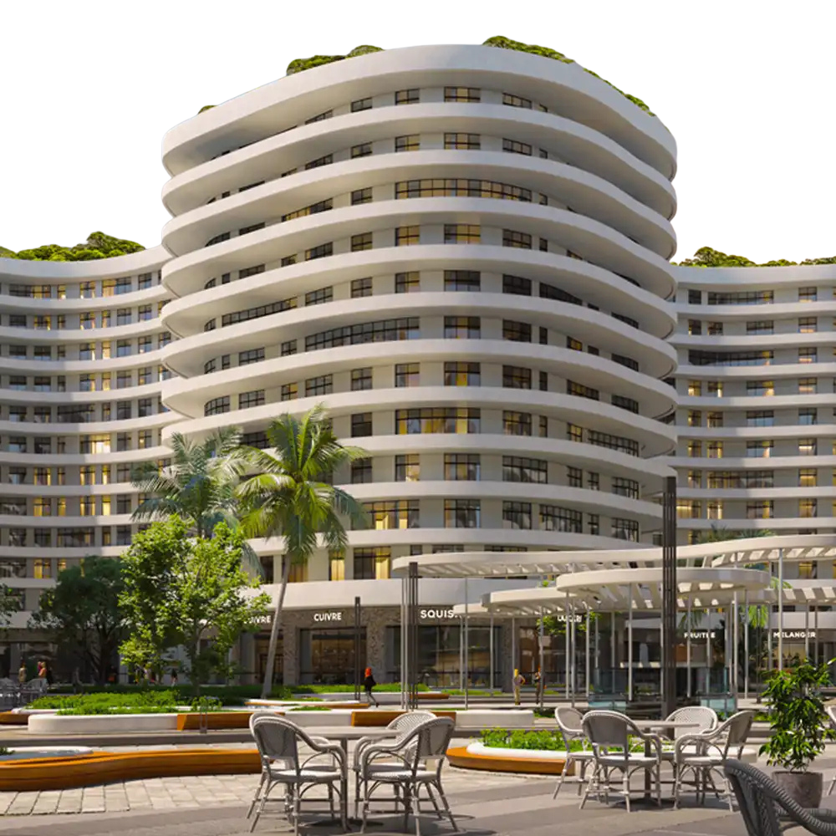

Real Estate Sales
& Collection Analytics
BY: AHMED MOHAMED
ALI MAGDY
KYRILLOS GABER
TAREK AHMED
YOUSSEF MOHAMED

Slide 2
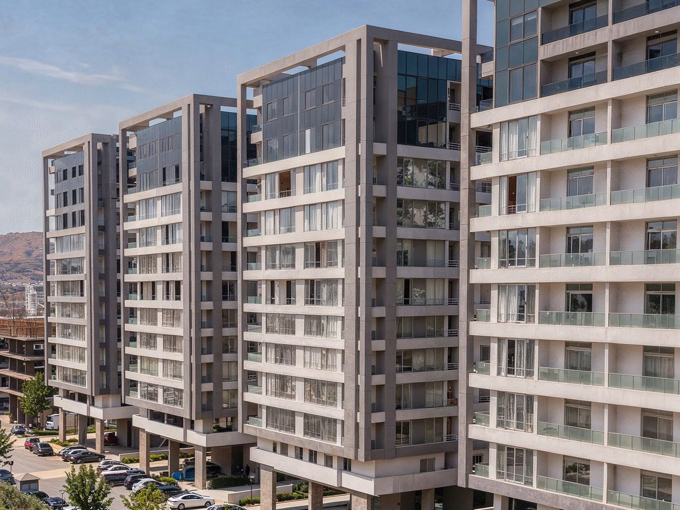
BUSINESS PROBLEM STATEMENT
The real estate company sells units through installment plans. However, the collection data is stored across multiple project worksheets, making it difficult to monitor the overall collection performance.
The main business challenges are:
Data is distributed across 8 project worksheets.
Installment information is stored in multiple columns and different business states.
Management needs to identify paid, due, and not-yet-due installments.
It is difficult to monitor collected and outstanding amounts in one place.
Management needs visibility into bank exposure and project progress.
The company needs a unified solution that provides a clear view of sales, collections, outstanding balances, and project performance.
8 Project Sheets
Different Installment Data
Difficult Analysis
Need for Unified Dashboard

Slide 3
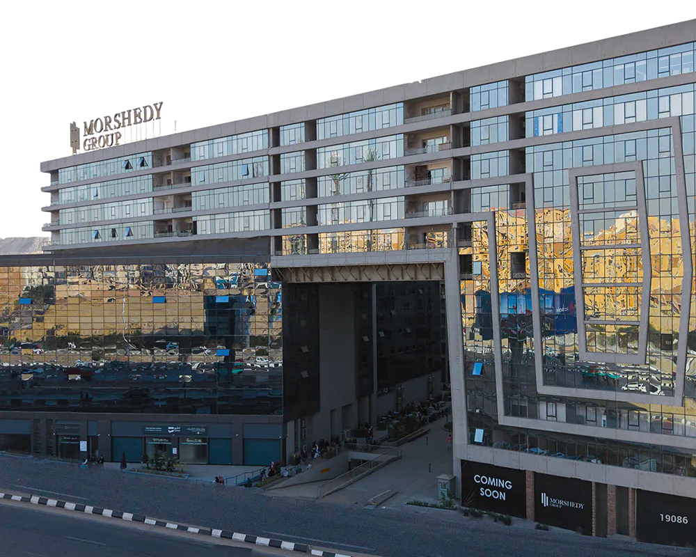
PROJECT MISSION & ANALYTICAL OBJECTIVES
Project Mission
To build a unified Power BI dashboard that helps management monitor sales performance, installment collections, outstanding balances, bank exposure, and project progress across all real estate projects.
Analytical Objectives
Analyze sales performance across projects.
Measure the number and percentage of sold units.
Track issued and collected installments.
Calculate collected and outstanding amounts.
Measure collection rate and outstanding percentage.
Monitor project completion percentage.
Separate Cash and Bank-financed sales.
Analyze outstanding balances by bank.
Compare collection performance between Old and New periods.

Slide 4
Problem
03
Complex Collections
Problem
02
Inconsistent Data
Problem
04
Limited Visibility
Problem
01
Multiple Projects
AT FIRST, IN ANY DATA ANALYSIS PROJECT, WE MAY FACE SOME PROBLEMS. SO, WHAT ARE PROBLEMS IN THIS PROJECT?
CORE PROBLEMS IN OUR PROJECT

Slide 5
Problem
02
Inconsistent Data
Problem
03
Complex Collections
Problem
04
Limited Visibility
Problem
01
Multiple Projects
CORE PROBLEMS IN OUR PROJECT

Slide 6
SO, WE MUST DO SOME STEPS TO PREPARE CLEAN DATA FOR OUR PROJECT!
STEP
02
STEP
04
STEP
01
STEP
03

Slide 7
INGESTION & DATA TRANSFORMATION
DATA MODEL
Tables were organized and connected using relationships and keys.
STEP
02
STEP
04
EXCEL
Source data was collected and prepared from the project Excel sheets.
STEP
01
STEP
03
Dashboard
The final data model was used to build interactive Power BI dashboards.
POWER QUERY
Data was cleaned, transformed, and combined into a structured format.

Slide 8
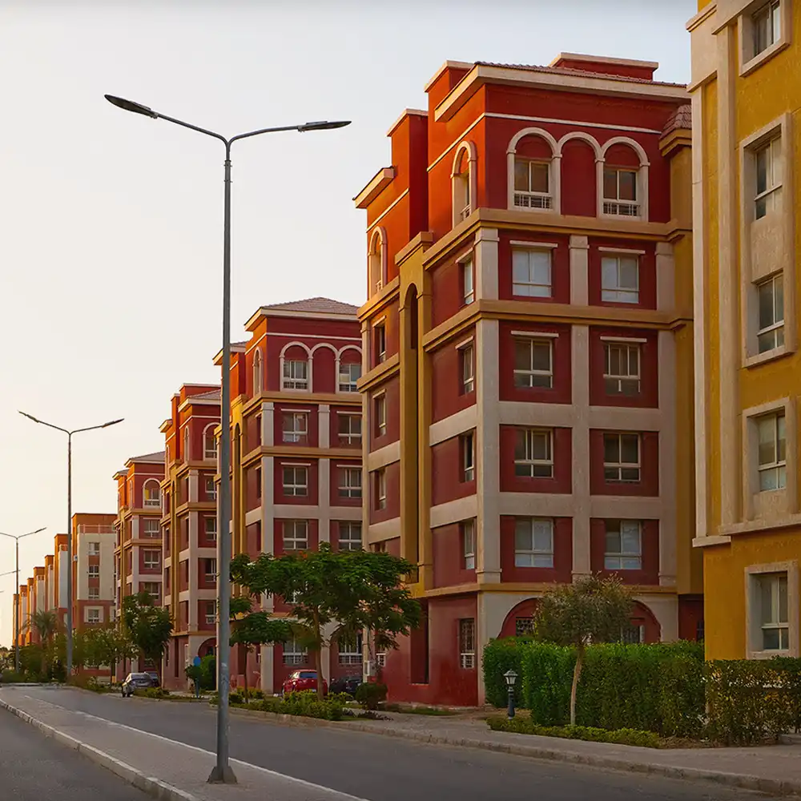
DAX BUSINESS LOGIC & MEASURES
Sales Measures | Collection Measures | Amount Measures | Project Measures | Time Analysis
Sold Count Sold % | Issued Invoices Collected Invoices Outstanding Invoices Collection Rate Outstanding % | Invoiced Amount Collected Amount Outstanding Amount Unit Price Bank Outstanding Cash Outstanding | Project Completion % | Old Records New Records
The measures follow the defined business rules and exclude the three control rows from customer-level calculations.

Slide 9
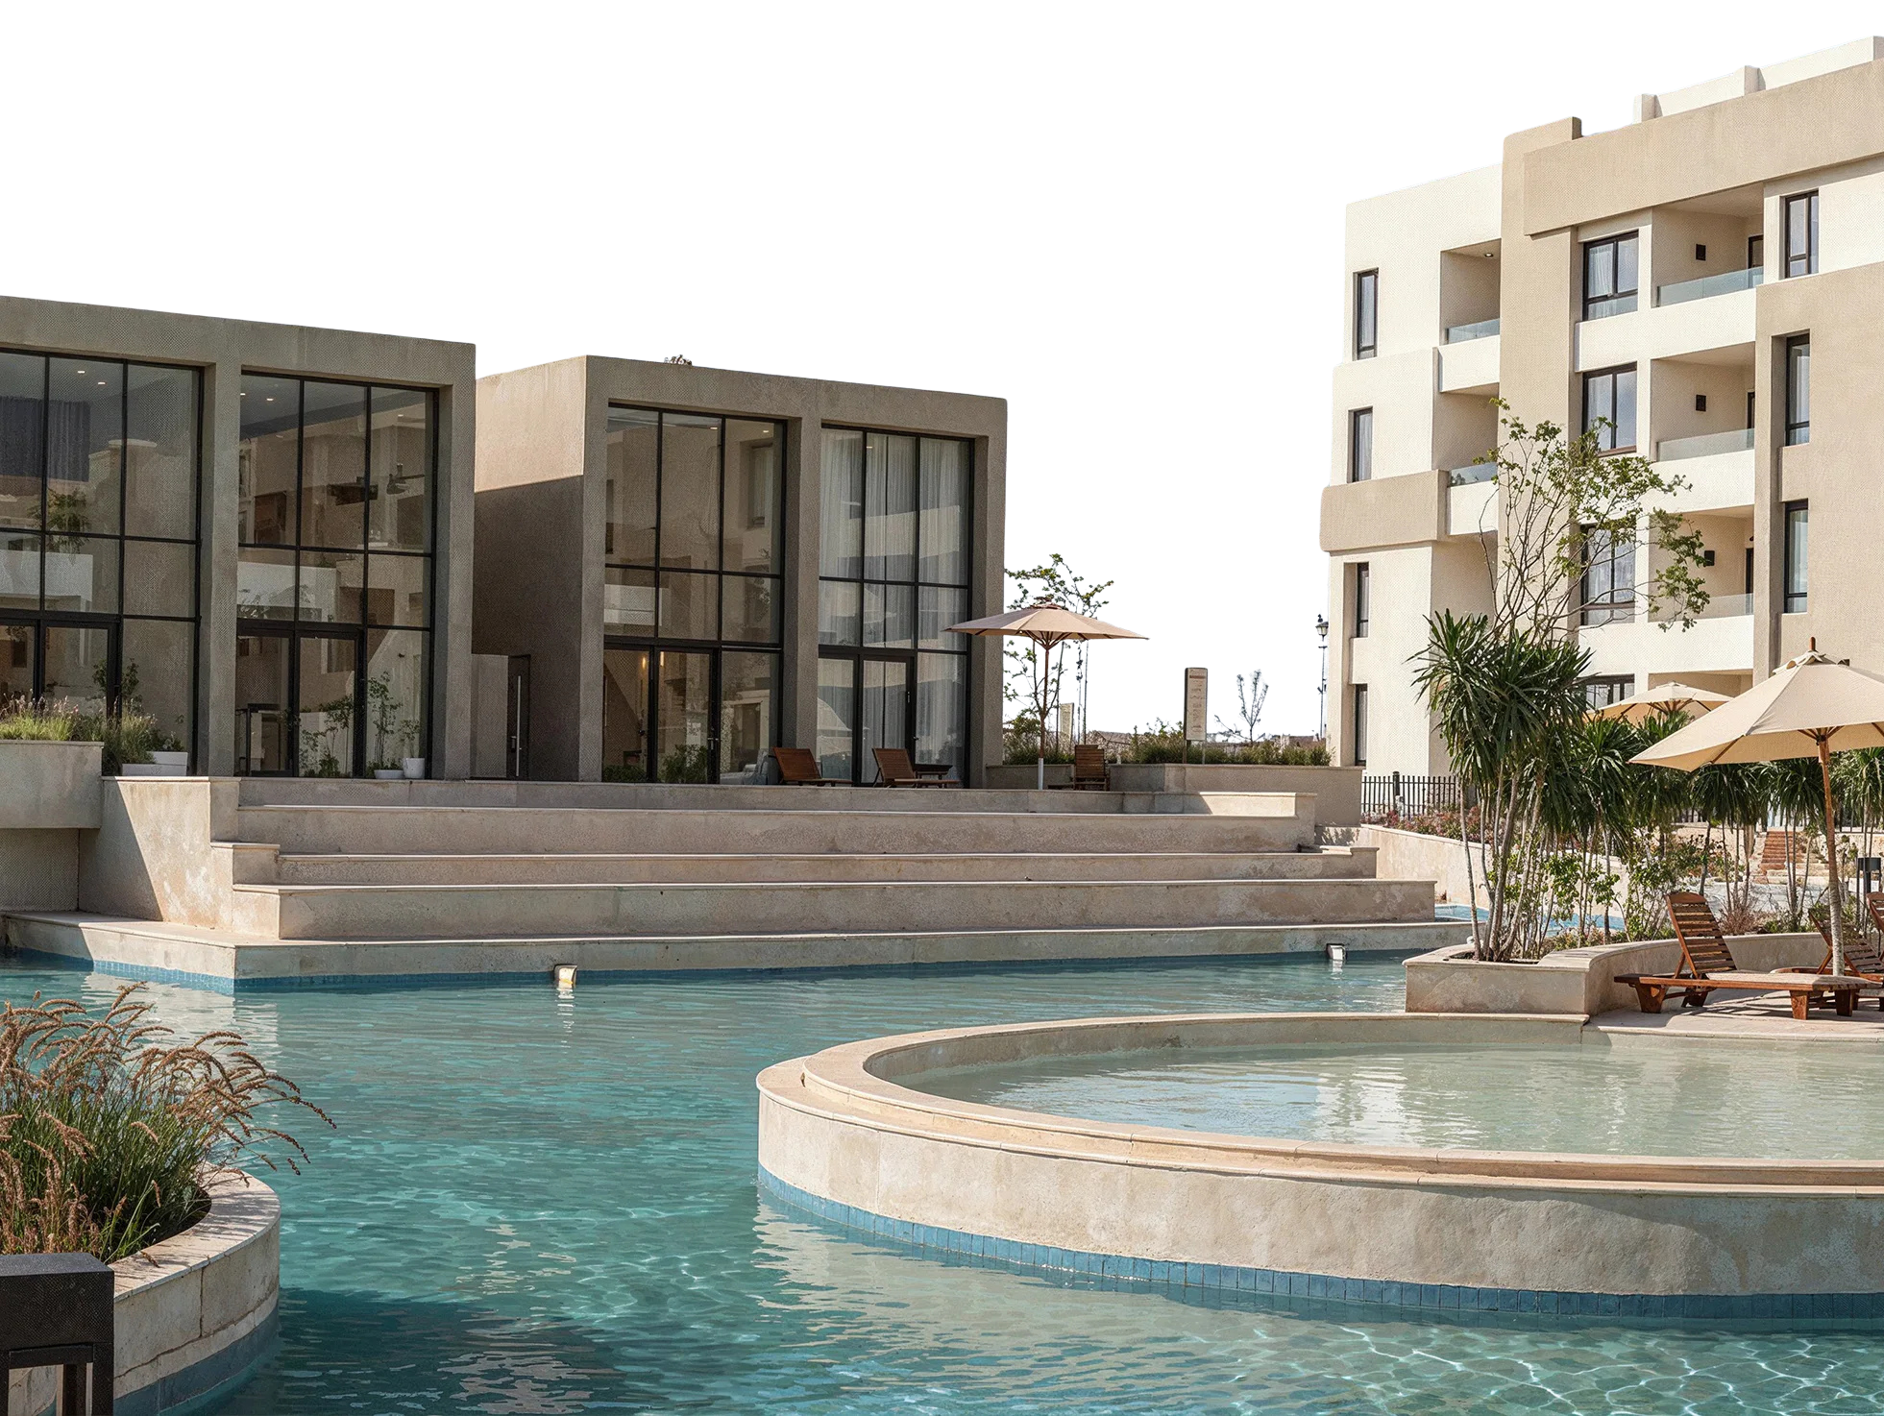
REPORT ARCHITECTURE & UI/UX DESIGN
Report Architecture
The report follows the required project architecture with a small improvement in the way the project pages are implemented.
Instead of creating separate pages for each project, we reduced the number of pages and used a Project Slicer to dynamically display the selected project on the same page.
This approach keeps the report more organized, reduces page repetition, and provides a more consistent user experience while still covering all required project views.

Slide 10

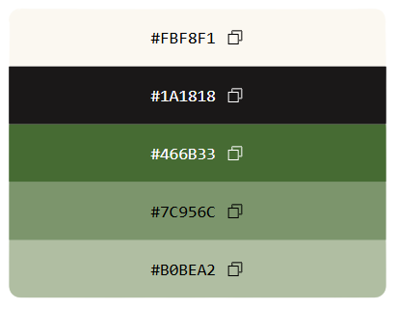
REPORT ARCHITECTURE & UI/UX DESIGN
UI/UX Design
The UI/UX design was developed to provide a clear, consistent, and user-friendly experience across the report.
The visual identity was inspired by MORSHEDY GROUP new logo, using its main colors as the foundation for the report's color palette.
The selected colors were applied consistently across cards, charts, slicers, navigation buttons, backgrounds, and other report elements to create a unified visual identity.
The color palette was derived from the new brand identity to maintain visual consistency throughout the report.

Slide 11
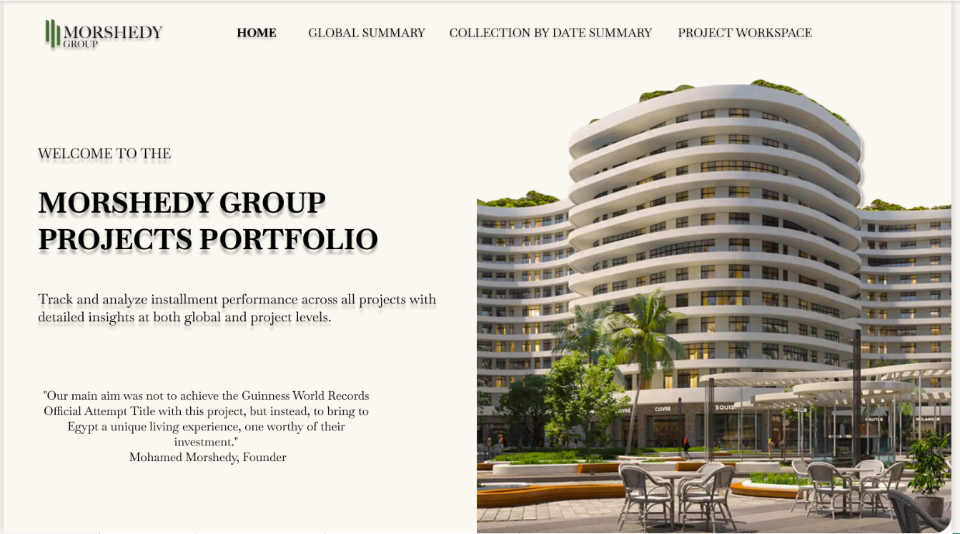
REPORT ARCHITECTURE & UI/UX DESIGN
Home Page

Slide 12
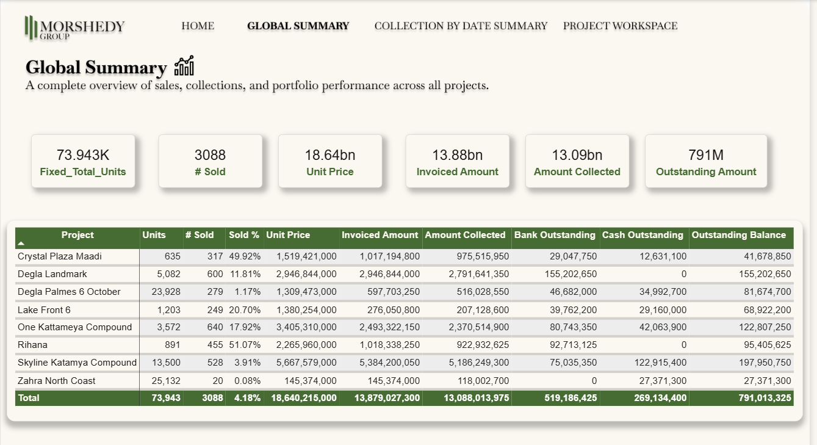
REPORT ARCHITECTURE & UI/UX DESIGN
Global Summary Page

Slide 13
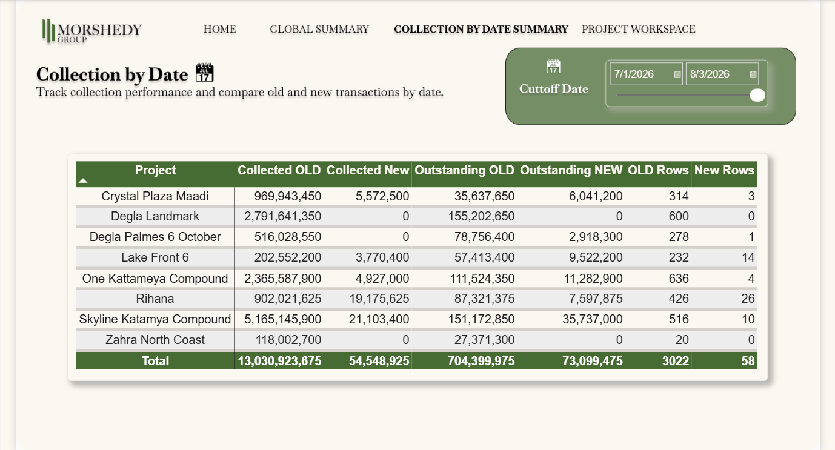
REPORT ARCHITECTURE & UI/UX DESIGN
Collection by date summary

Slide 14
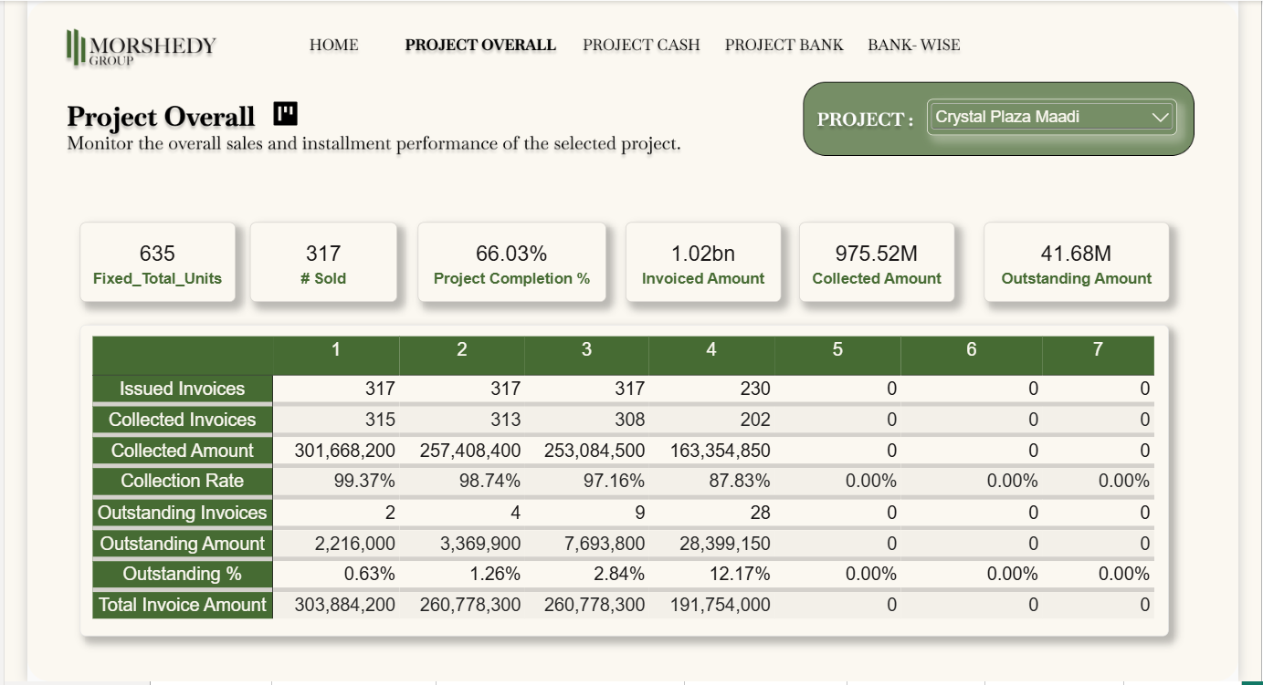
REPORT ARCHITECTURE & UI/UX DESIGN
Project Overall

Slide 15
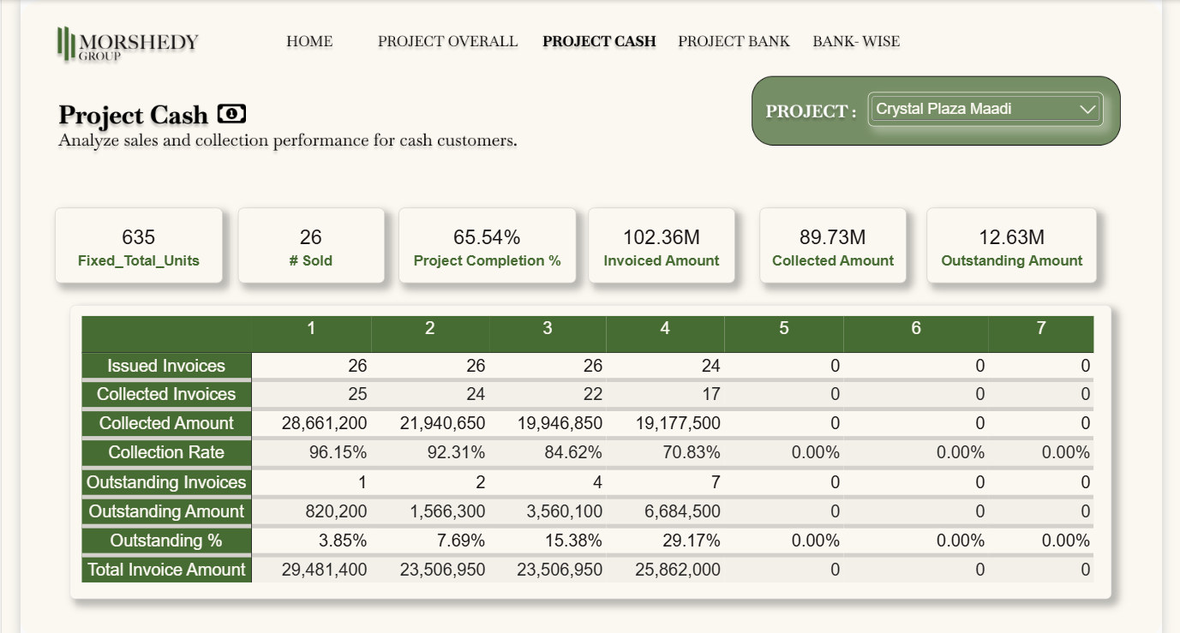
REPORT ARCHITECTURE & UI/UX DESIGN
Project Cash

Slide 16

REPORT ARCHITECTURE & UI/UX DESIGN
Project Bank

Slide 17
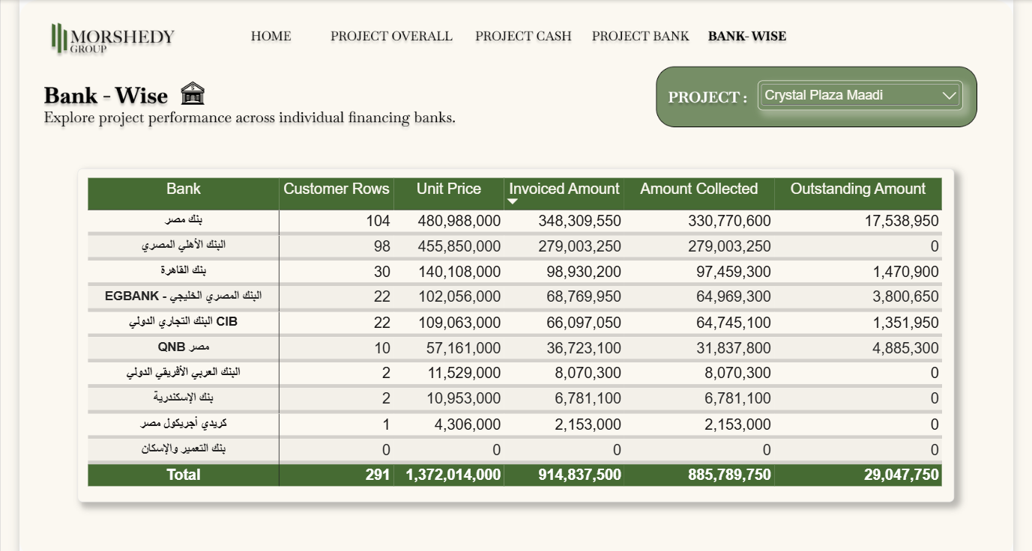
REPORT ARCHITECTURE & UI/UX DESIGN
Bank - Wise

Slide 18
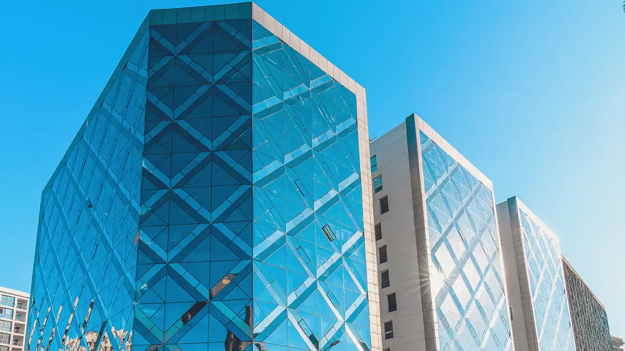
INSIGHTS & RECOMMENDATIONS
1. Strong Overall Collection Performance
Insight:
Across the 8 projects, 3,088 units were sold with a total sold-unit value of approximately EGP 18.64B. The dashboard shows EGP 13.88B in invoiced amounts, of which EGP 13.09B has been collected. This gives an overall collection rate of approximately 94.3% by amount, while the remaining outstanding balance is about EGP 791.0M.
Recommendation:
Management should maintain the current collection follow-up process while giving special attention to the remaining EGP 791.0M outstanding balance.
Business Value:
This gives management a clear view of the portfolio's overall collection position.
2. Outstanding Balance Is Concentrated in Three Projects
Insight:
The total outstanding balance is approximately EGP 791.0M. Three projects account for about 60.2% of this amount:
Skyline Katamya Compound: EGP 198.0M
Degla Landmark: EGP 155.2M
One Kattameya Compound: EGP 122.8M
Together, these three projects represent approximately EGP 476.0M of the total outstanding balance.
Recommendation:
Management should give these projects closer collection monitoring and review their outstanding installments regularly.
Business Value:
Focusing on the projects with the largest outstanding balances can help management monitor the largest collection exposures.

Slide 19
INSIGHTS & RECOMMENDATIONS
3. Installment 7 Has the Largest Collection Gap
Insight:
Installment 7 shows a major collection gap. Out of approximately EGP 158.7M issued for this installment, only EGP 3.35M has been collected, leaving around EGP 155.4M outstanding.
The collection rate for Installment 7 is only about 2.1%, compared with much higher rates for the earlier installments.
Recommendation:
The collection team should closely monitor Installment 7 and follow up on unpaid amounts as they become due.
Business Value:
Installment 7 represents the largest installment-level outstanding exposure in the portfolio.
4. Installments 4 and 5 Also Need Collection Monitoring
Insight:
Collection performance decreases in the later installment stages. Installment 4 has a collection rate of about 92.0%, while Installment 5 is about 92.5%. Their outstanding balances are approximately EGP 175.3M and EGP 110.9M, respectively.
Recommendation:
Management should increase follow-up for later installments, especially Installments 4 and 5, before unpaid balances become larger.
Business Value:
The analysis shows that collection attention should not focus only on the first installments.

Slide 20
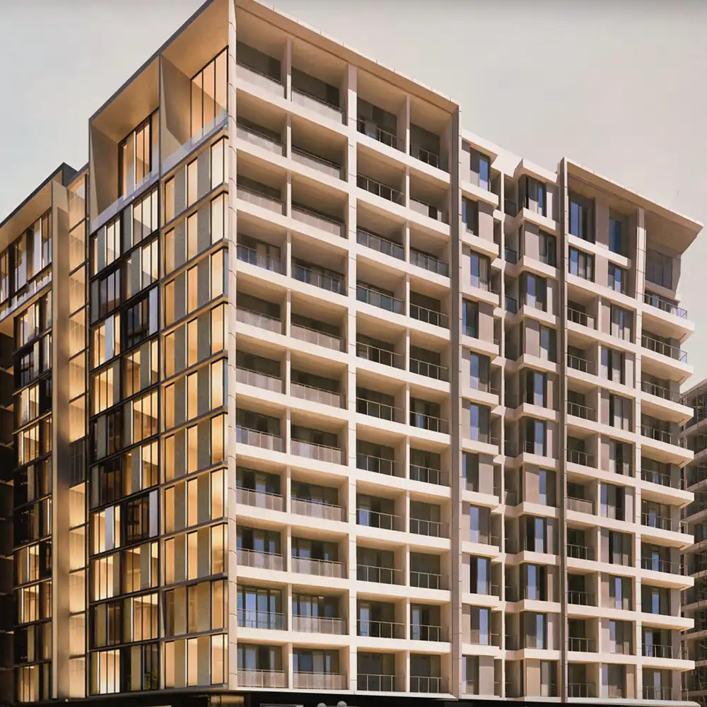
INSIGHTS & RECOMMENDATIONS
6. Outstanding Bank Exposure Is Concentrated in Two Banks
Insight:
Within the bank-financed portfolio, Banque Misr has approximately EGP 152.2M outstanding, while National Bank of Egypt has approximately EGP 150.7M outstanding.
Together, these two banks represent around 58.0% of the total bank outstanding balance of EGP 521.9M.
Recommendation:
Management should regularly monitor outstanding balances by bank and strengthen follow-up for the banks with larger outstanding exposure.
Business Value:
Bank-wise analysis helps identify where a large part of the financed outstanding balance is concentrated.

Slide 21

THANK YOU

